Slide 1
Review
1. How software bugs impact our lives
2. What bugs are and why they occur
3. Who software testers are and what they do
4. What major components go into a software product
5. What different people and skills contribute to a software product
6. How software progresses from an idea to a final product
Notes:
1. 了解上节课给大家留的任务完成情况。
2. 上节课讲了两个大问题：那两个？
3. 知识点的复习（6个）
4. 补充上节课讲的不透彻的地方：
a. 软件过程bug修改的费用，在图中给出软件过程中人员投入情况
b. 测试工程师应具备的素质：细心和耐心、打破沙锅问到底、编程、好学

Slide 2
1. Testing Axioms
2. Software Testing Terms and Definition
Notes:
1. 引题，从理想到现实。
问大家一个问题，我们上一次课讲到的内容（理论）在现实中是否存在？比如：螺旋开发过程、详细而准确的产品需求规格说明书。
很多测试新手满怀下面的信念进入软件测试领域：
a. 他们能够充分地测试每一个程序；
b. 通过完全测试，他们能够确保程序正常运行；
c. 测试人员的工作任务就是通过进行完全测试，来保证程序的正确性；
一旦认识到这样的使命无法实现，很多测试人员的积极性就会遭到打击。他们会怀疑所在的公司是不是正值（因为公司不愿意提供完全测试所需的资金），开始怀疑自己的职业操守。在认识到无法“正确地”工作后，有些软件测试人员需要花一段时间来领会如何“较好地”工作。
2. 这个章节讲述的大体内容
3. 我们能够学到什么东西

Slide 3

1. Testing Axioms
It's Impossible to Test a Program Completely
  The number of possible inputs is very large.
  The number of possible outputs is very large.
  The number of paths through the software is very large.
  The software specification is subjective.
Notes:
1. 分析原因
2. 举例说明（计算，算完之后进行补充说明：有效输入、无效输入、编辑功能、各种时机、多项功能）
3. 引申出good-enough经济原则（成本和质量的平衡，投入和产出的平衡）
good-enough原则
对于相对复杂的产品或系统来说，zero-bug是一种理想，good-enough是我们的原则。Good-enough原则就是一种权衡投入／产出比的原则：不充分的测试是不负责任的；过分的测试是一种资源的浪费，同样也是一种不负责任的表现。我们的操作困难在于：如何界定什么样的测试是不充分的，什么样的测试是过分的。目前状况唯一可用的答案是：制定最低测试通过标准和测试内容，然后具体问题具体分析。
4. 结论
如果觉得某些测试条件是重复的或者没有必要的或者为了节省时间，而将其剔除，那么你就已经放弃了完全测试。
5. 看图

Slide 4
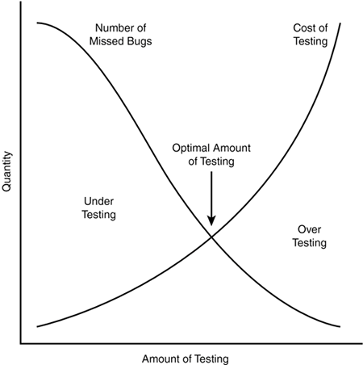
Figure: Software Testing is Risk-Based Exercise
Notes:
说明了测试量和发现软件缺陷数量以及测试成本之间的关系。一个平衡。

Slide 5
1. Testing Axioms
Software Testing Is a Risk-Based Exercise
Notes:
1. 由上一个原则引入。
2. 举两个失效的例子：
一个数据库管理程序丢弃大小为512字节整数倍的数据文件，而另一个则不能处理大小为16384字节或者是该长度整数倍的文件，即使这些文件是由数据库管理程序本身创建的。
一个字处理软件在处理比较大（100000字节）且物理上分成几段（各段存储在磁盘的不相邻位置上）的文本时就会犯糊涂。进行编辑操作后没什么问题，再移动几次光标却可能导致某段文本突然消失。
在对程序的所有“似乎合理”的输入进行测试时，不太可能包含以上这些特殊的用例。但是问题确实存在。
3. 结论：
软件测试人员要学会的一个主要原则是如何把无边无际的测试范围减少到可以控制的范围；以及如何针对风险作出明智的选择，那些是重要的，需要测试，那些不太重要可以减少测试。

Slide 6
1. Testing Axioms
Testing Can't Show That Bugs Don't Exist
Notes:
略讲。

Slide 7
1. Testing Axioms
The More Bugs You Find, the More Bugs There Are
  Programmers have bad days.
  Programmers often make the same mistake.
  Some bugs are really just the tip of the iceberg.
Notes:
1. 说明是群集现象
2. 原因分析
3. 引申80-20原则
Pareto原则应用于软件测试。简单地讲，Pareto原则暗示着测试发现的错误中的80％很可能起源于程序模块中的20％。当然，问题在于如何孤立这些有疑点的模块并进行彻底的测试。一般情况下，在分析、设计、实现阶段的复审和测试工作能够发现和避免80%的Bug，而系统测试又能找出其余Bug中的80%，最后的5%的Bug可能只有在用户的大范围、长时间使用后才会曝露出来。因为测试只能够保证尽可能多地发现错误，无法保证能够发现所有的错误。

Slide 8
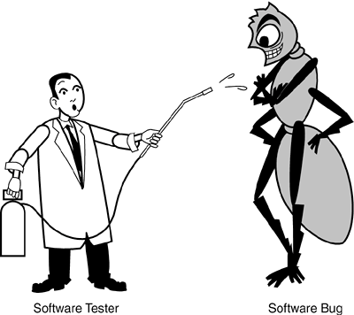
The Pesticide Paradox
1. Testing Axioms
The Pesticide Paradox
Notes:
creative

Slide 9
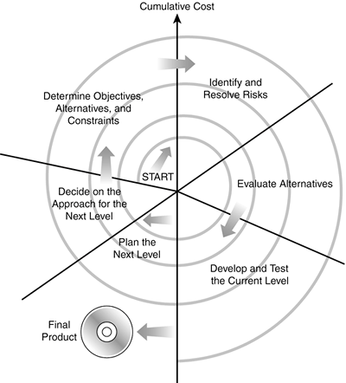
Figure: Software Testing is Risk-Based Exercise

Slide 10
1. Testing Axioms
Not All the Bugs You Find Will Be Fixed
  There's not enough time.
  It's really not a bug.
  It's too risky to fix.
  It's just not worth it.
Notes:
judgement

Slide 11
1. Testing Axioms
When a Bug's a Bug Is Difficult to Say
Notes:
略讲。结合bug的规范定义。

Slide 12
1. Testing Axioms
Product Specifications Are Never Final
Notes:
略讲。

Slide 13
1. Testing Axioms
Software Testers Aren't the Most Popular Members of a Project Team
  Find bugs early.
  Temper your enthusiasm.
  Don't just report bad news.

Slide 14
1. Testing Axioms
Software Testing Is a Disciplined Technical Profession

Slide 15
1. Testing Axioms
It's Impossible to Test a Program Completely
Software Testing Is a Risk-Based Exercise
Testing Can't Show That Bugs Don't Exist
The More Bugs You Find, the More Bugs There Are
The Pesticide Paradox
Not All the Bugs You Find Will Be Fixed
When a Bug's a Bug Is Difficult to Say
Product Specifications Are Never Final

Slide 16
1. Testing Axioms
Software Testers Aren't the Most Popular Members of a Project Team
Software Testing Is a Disciplined Technical Profession

Slide 17
1. Testing Axioms
2. Software Testing Terms and Definitions
Precision and Accuracy

Slide 18
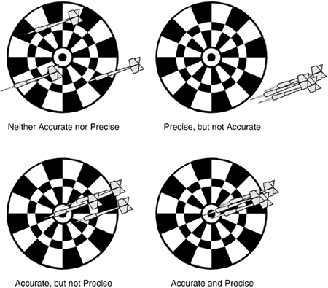
Figure: Precision and Accuracy

Slide 19
1. Testing Axioms
2. Software Testing Terms and Definitions
Verification and Validation
  Verification is the process confirming that something software meets its specification.
  Validation is the process confirming that it meets the user's requirements.

Slide 20
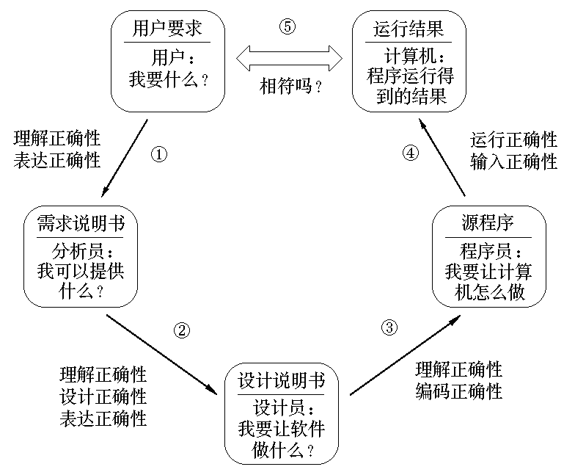
Figure: Precision and Accuracy

Slide 21
1. Testing Axioms
2. Software Testing Terms and Definitions
Quality and Reliability

Slide 22
1. Testing Axioms
2. Software Testing Terms and Definitions
Testing and Quality Assurance (QA)
  The goal of a software tester is to find bugs, find them as early as possible, and make sure they get fixed.
  A software quality assurance person's main responsibility is to create and enforce standards and methods to improve the development process and to prevent bugs from ever occurring.

Slide 23
1. Testing Axioms
2. Software Testing Terms and Definitions
Black-Box and White-Box Testing

Slide 24
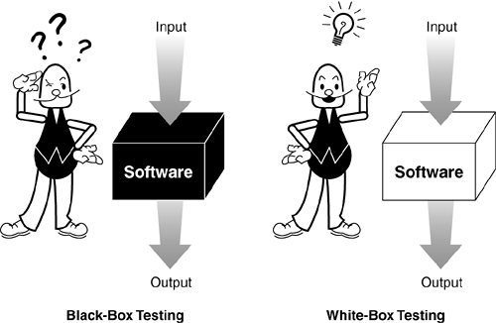
Figure: Black-Box and White-Box Testing

Slide 25
1. Testing Axioms
2. Software Testing Terms and Definitions
Static and Dynamic Testing

Slide 26
1. Testing Axioms
2. Software Testing Terms and Definitions
Precision and Accuracy
Verification and Validation
Quality and Reliability
Testing and Quality Assurance (QA)
Black-Box and White-Box Testing
Static and Dynamic Testing

Slide 27
Quiz:

Slide 28
1. Testing Axioms
2. Software Testing Terms and Definition

